Slide 1

ROBOTICS WORKSHOP 2017

Slide 2
BASICS OF PROGRAMMING
LOCOMOTION
ARDUINO BASICS
WIRED LOCOMOTION
(DTMF & JOYSTICK)
ARDUINO INPUT OUTPUT
WIRELESS LOCOMOTION
(BLUETOOTH & VOICE CONTROL)
MOTOR
PROTEUS
MIT APP INVENTOR

Slide 3
BASICS OF PROGRAMMING
Constants
Variables
Loops
Conditional statements
Functions

Slide 4
CONSTANTS
A constant is a value that cannot be altered by the program during normal execution
Eg.
const double PI=3.14
#define PI 3.14

Slide 5
VARIABLE
A space in the memory where the user can store any value, and can be changed throughout the program
Eg.
float a
int x

Slide 6
LOOPS
A loop is a sequence of instructions, that are repeated until a certain condition is reached.
Most commonly used loops are
For loop
While loop
Do while loop

Slide 7
FOR LOOP
The basic syntax of a for loop is :
for(initialization ; test ;incrementation/decrementation )
Example :
for(i=0;i<5;i++)
{
printf(“Hello \n”);
}

Slide 8
WHILE LOOP
Syntax :
while(condition)
Example :
i=0;
while(i < 5)
{
printf(“Hello \n”);
i++;
}

Slide 9
Do… while loop ..
Syntax :
do
{
statements;
}
while(condition);

Slide 10
Do …while loop..
Example :
i=0;
do
{
printf(“Hello \n”);
}
while(i<5);

Slide 11
Conditional Statements…
if
If .. else
If .. else (nested / cascading)
Switch statement

Slide 12
if Statement
Syntax:
if(condition)
{
Statements;
}
Example :
i=0;
if(i==0)
{
printf(“Hello”);
}

Slide 13
if … else statement
Syntax :
if(condition)
{
Statements;
}
else
{
Statements;
}

Slide 14
if … else statement
Example :
i=0;
if( i > 0)
{
printf(“Hello ”);
}
else
{
printf(“World ”);
}

Slide 15
Switch Statement
Syntax :
switch(case variable)
{
case 1: Statements;
break;
case 2: Statements;
break;
.
.
.
.
case n: Statements;
break;
default : statements;
}

Slide 17
MICROCONTROLLER
What is microcontroller?
It is a small computer capable of performing specific task(s)
Fundamental components of microcontroller:
Central processing unit(CPU)
Memory unit
System clock (Oscillator)
Peripherals

Slide 18

Arduino is an open source platform based on easy to use hardware and software
Hardware- Arduino family of boards
Software- Arduino IDE

Slide 19
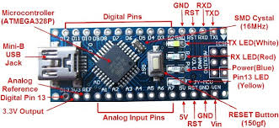

Slide 20
Arduino programs can be divided in three main parts:
1.) Structure
2.) Values (constants)
3.)Functions.

Slide 21
Functions
Digital I/O
pinMode()
digitalWrite()
digitalRead()

Slide 22
Analog I/O
analogRead()
analogWrite() - PWM

Slide 23
Time
millis()
This function returns the number of milliseconds the current sketch has been running since the last reset
delay()
delay function is used to suspend execution of a program for a particular time.

Slide 24
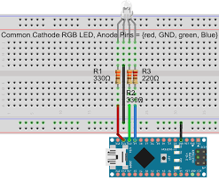
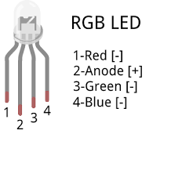
INTERFACING LED WITH ARDUINO
LED is an output device for arduino

Slide 25
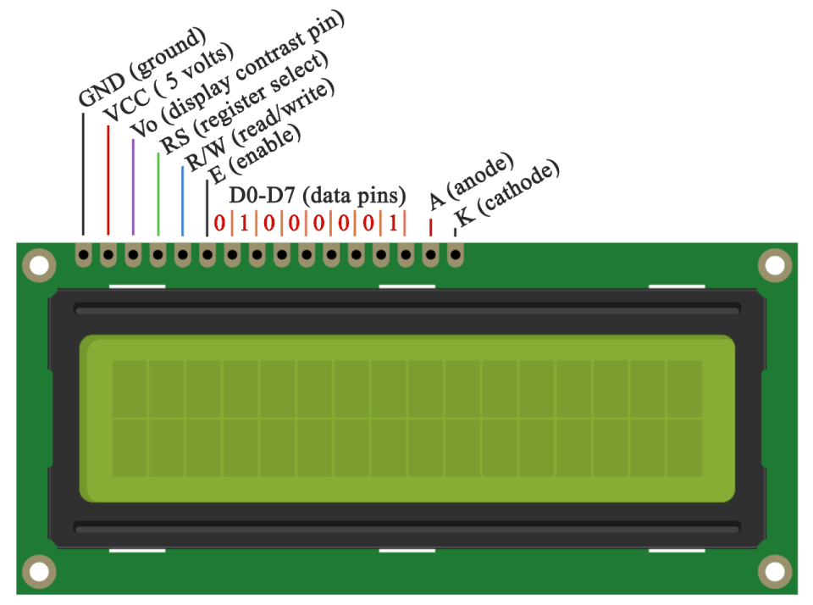
INTERFACING LCD WITH ARDUINO
LCD RS pin to digital pin 12
LCD Enable pin to digital pin 11
LCD D4 pin to digital pin 5
LCD D5 pin to digital pin 4
LCD D6 pin to digital pin 3
LCD D7 pin to digital pin 2
LCD R/W pin to ground
LCD VSS pin to ground
LCD VCC pin to 5V
1K resistor:
ends to +5V and ground
wiper to LCD VO pin (pin 3)

